Slide 1


Predicting Loan Defaults
Using ML
Moving from Reactive Recovery to Proactive Risk Management.

Slide 2

The Scenario Current State
Meet Alex.
Alex is a Bank Manager. His biggest headache? NPAs (Non-Performing Assets).
Every quarter, he has to explain to the board why certain loans have gone bad and how much it will cost to recover them.

Slide 3




What is an NPA? Definition
The Definition
The Impact
A loan becomes a Non-Performing Asset when the borrower fails to pay interest or principal for 90 days.
NPAs freeze the bank's capital. The money is stuck, earning no interest, and often requires costly legal action to recover.

Slide 4

The Big Picture in Banking Sector
March 2021
March 2025
9.11%
2.58%
Gross NPA
Gross NPA
"Wow! Defaults have disappeared!" ... Or have they?

Slide 5

The "Write-Off" Reality
It's Not Fewer Defaults.
The drop is largely due to technical write-offs.
Banks remove long-defaulted loans from their active balance sheet to clean up their books, as per RBI guidelines. The default happened, but it's hidden from the headline ratio.

Slide 6







Why Write Off? Strategic Benefits
Stronger Metrics
Tax Shield
Lending Power
Improved NPA ratio signals financial health to investors and regulators.
Written-off amounts are treated as losses, reducing the bank's taxable income.
A cleaner balance sheet allows the bank to lend aggressively again.

Slide 7

The Hidden Stat Persistent Risk
5.5 - 6%
The Core Problem Remains
Writing off a loan cleans the book, but it doesn't recover the money. The bank has still lost the principal.
Of every 100 loans disbursed still eventually move into NPA status.
We are managing the symptom, not curing the disease.

Slide 8


The Old Way Reactive Recovery
Costly & Inefficient
Expensive third-party recovery agencies.
Legal fees pile up over years.
Recovery rates are often less than 30%.

Slide 9
Building a Machine Learning Model to tackle the problem
Shifting from Recovery to Prediction.

Slide 10



Benefit 1 Cost Efficiency
Stop the Bleeding
By predicting defaults before they happen, banks can avoid the entire recovery process.
Impact: Saving millions in agency fees and legal costs directly boosts the bottom line.

Slide 11

Benefit 2 Early Intervention
Proactive Alerts
The ML model acts like a radar.
It identifies high-risk borrowers months before the first missed payment based on subtle behavioral patterns (e.g., spending habits, credit utilization spikes).
This allows the bank to offer restructuring or counseling early.

Slide 12

Benefit 3 Dynamic Pricing
Risk-Based Interest
One size does not fit all.
The model assigns a precise Probability of Default (PD) to every applicant.
•
Low Risk: Offer lower rates to attract best customers.
•
High Risk: Charge a premium to cover potential losses.

Slide 13








The ML Roadmap End-to-End Pipeline
Sourcing
Cleaning
EDA
Features
Hyperparameter Tuning
Model
Impact

Slide 14

Step 1: Data Sourcing The Foundation
External Data
Kaggle Link: Loan Default Data
•
Demographics (Age, Income, Region)
•
Transaction History
•
Loan Details (Tenure, Amount) and other details

Slide 15
Step 2: Data Cleaning Quality Control
Missing Values: Imputed numerical nulls with Median (robust to outliers) and categorical with Mode.
Skewness : Performed log transformation to handle the data skewness
Sanity Checks: Removed negative values for income and duplicate loan IDs.

Slide 16
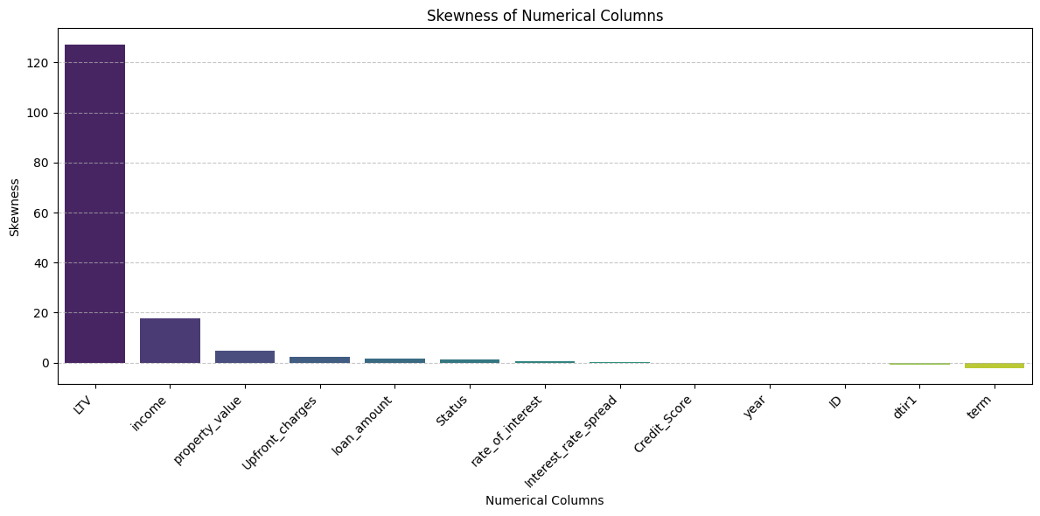
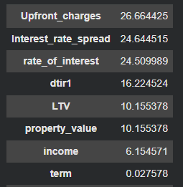
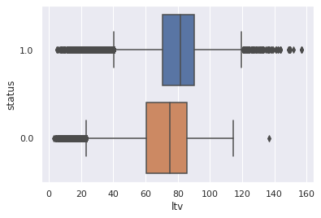
PERCENTAGE OF MISSING VALUES
Step 2: Data Cleaning Quality Control
Skewness after log transformation:
LTV -2.139832
income -5.266832
property_value -0.070577
Upfront_charges -1.790133
loan_amount -0.396572
Status 1.176762
term 1.739486
dtype: float64

Slide 17
Step 2: Data Cleaning Quality Control
SimpleImputer:
Numerical Columns:
Categorical Columns:
simple_imputer = SimpleImputer(strategy='median')
cols_to_impute = missing_precentage_num_df[missing_precentage_num_df >0].keys()
temp = df[cols_to_impute]
X_imputed = simple_imputer.fit_transform(temp)
num_df_imputed = pd.DataFrame(
X_imputed,
columns=cols_to_impute,
)
num_df[cols_to_impute] = num_df_imputed
df[num_df.columns] = num_df
df.isnull().sum()
categorical_transformer = Pipeline([
('imputer', SimpleImputer(strategy='most_frequent')),
('onehot', OneHotEncoder(handle_unknown='ignore', sparse_output=False))
])
preprocessor = ColumnTransformer([
('cat', categorical_transformer, cat_cols)
])

Slide 18
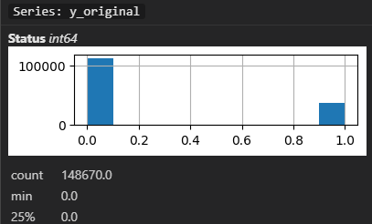
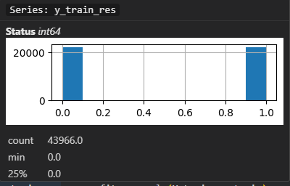
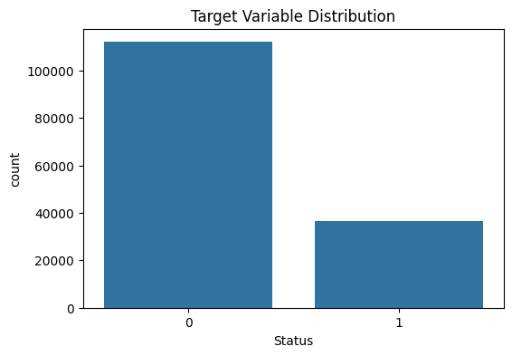
Step 3: EDA The Class Imbalance

Slide 19
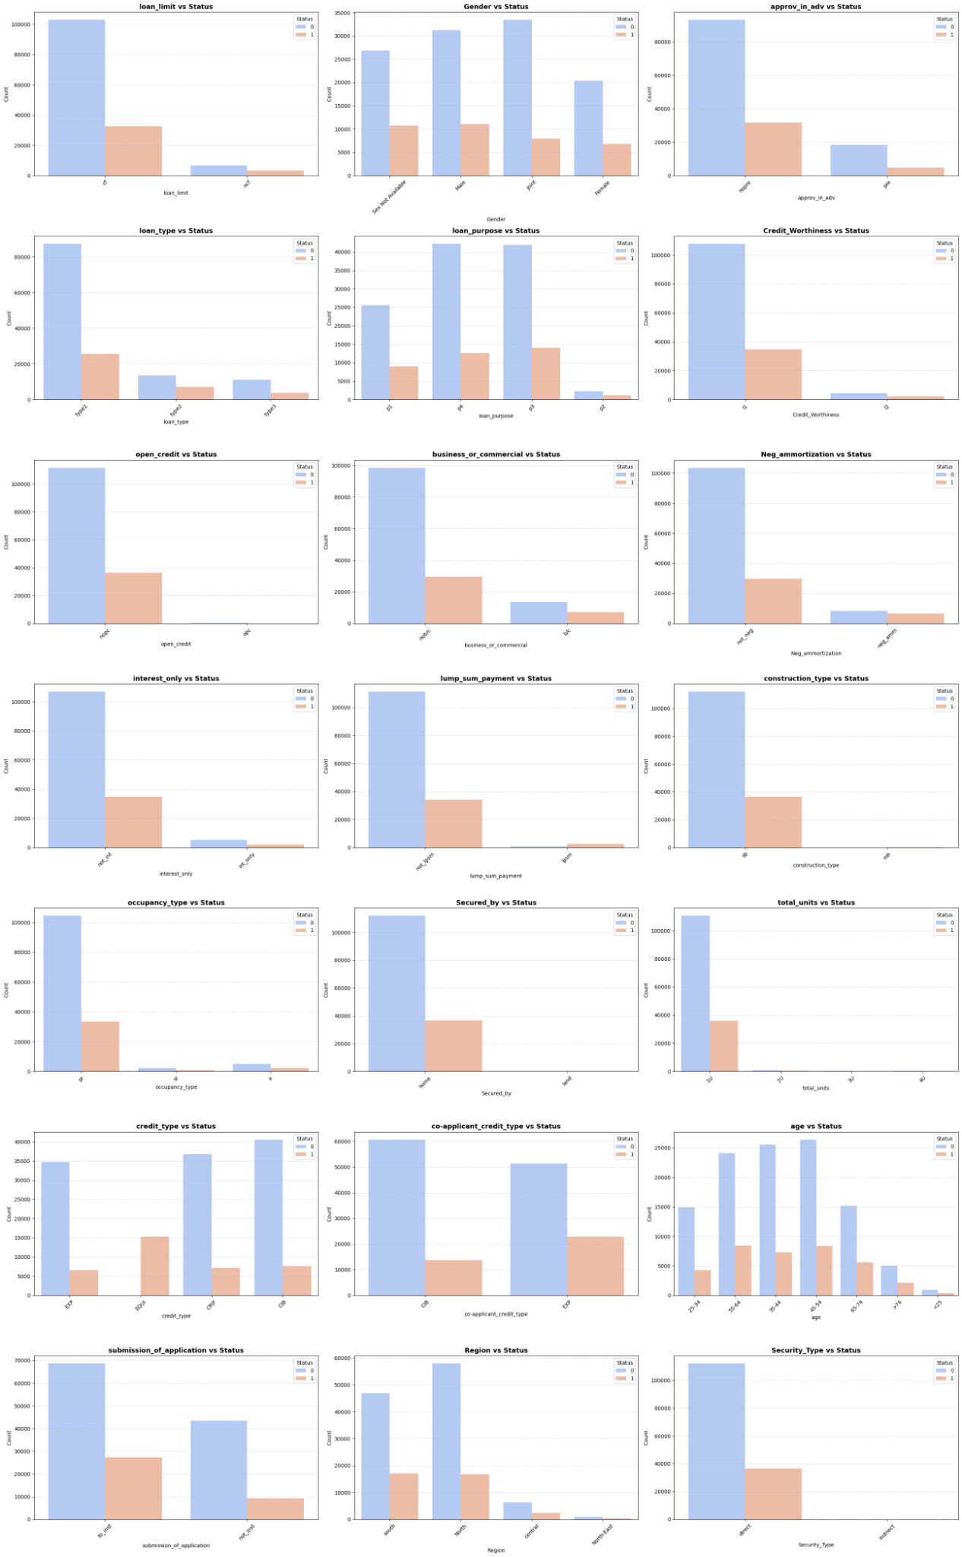
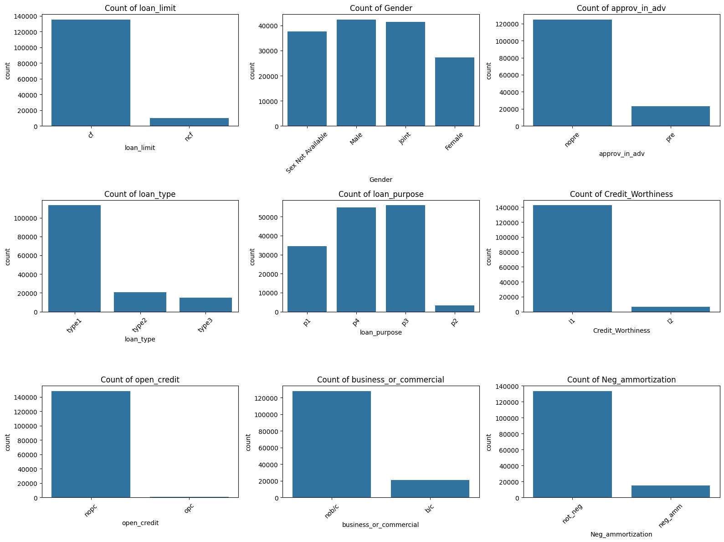
Step 3: EDA Key Drivers

Slide 20
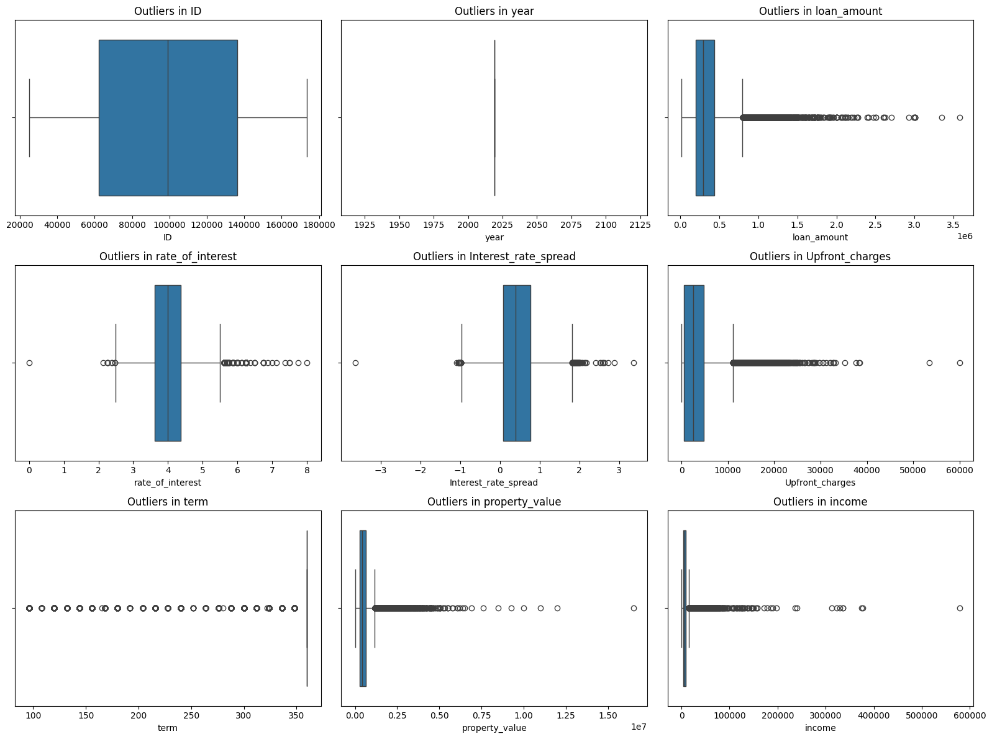
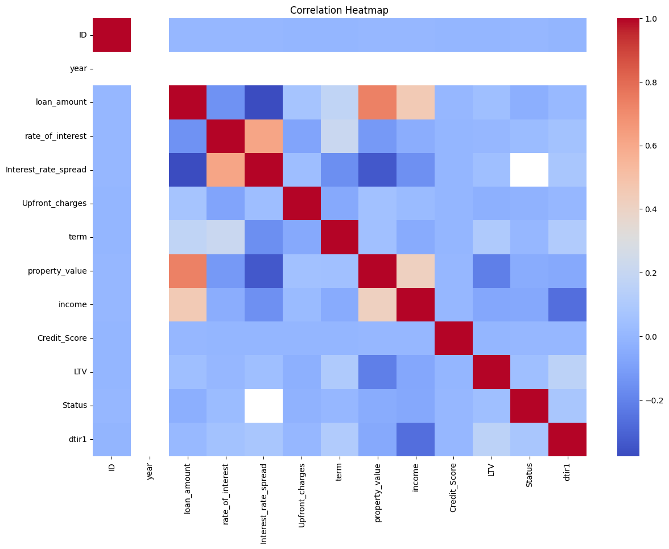
Step 3: EDA Key Drivers

Slide 21
Step 4: Preprocessing Preparing Data
Scaling
Encoding
Applied StandardScaler to numerical features (Income, Loan Amount).
Applied One-Hot Encoding to categorical features (Education, Loan Purpose).
Ensures that high-value features don't dominate the distance calculations in the model.
Converts text categories into binary vectors (0/1) for the machine to understand.

Slide 22

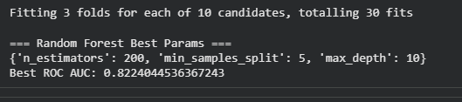
Step 5: Hyperparameter Tuning

Slide 23
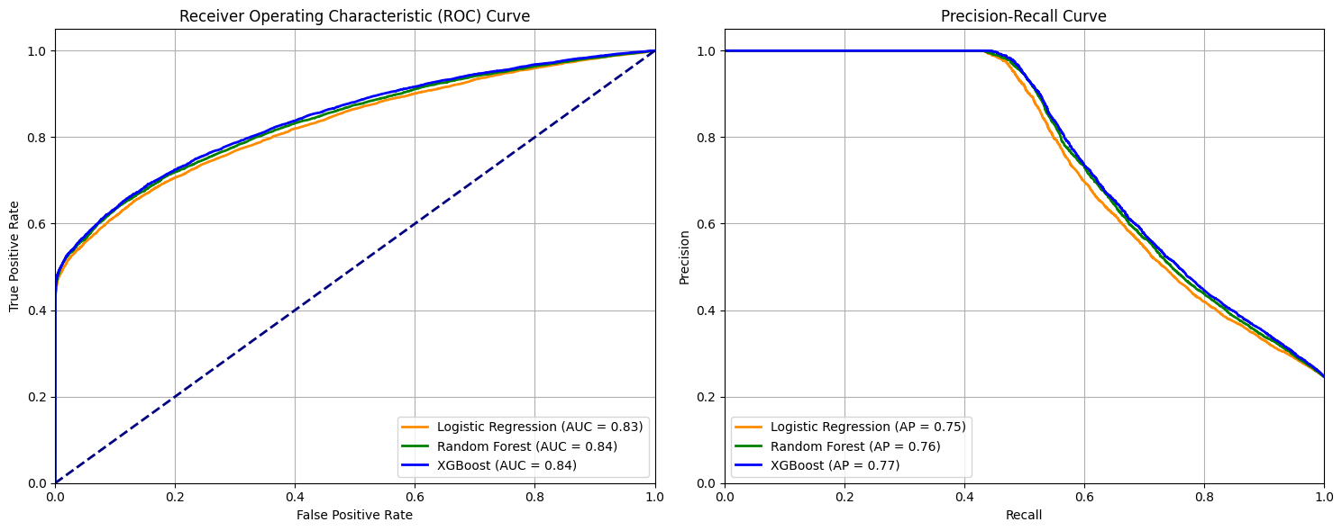
Step 5: Model Performance

Slide 24
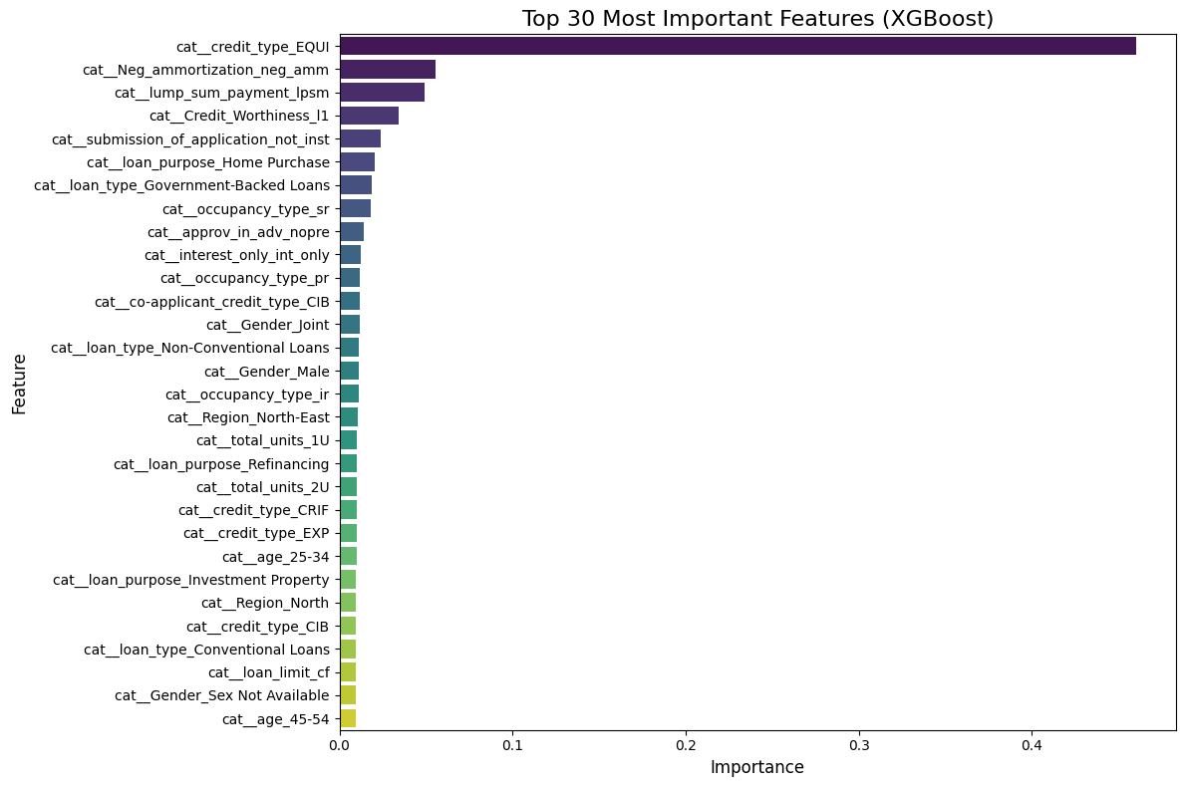

Slide 25




Thank you!
Group 1 :
Dheekshith B G
Mahith
Mouneesh
Ninad
Green Bucket (< 20%)
Auto-Approve. Fast track.
Amber Bucket (20-60%)
Manual Review. Ask for collateral.

